Slide 1
Network Models
Department of Computer Science, Presidency University

Slide 2
Agenda
Two models have been devised to define computer network operations: the TCP/IP protocol suite and the OSI model
The first section introduces the concept of protocol layering using two scenarios. The section also discusses the two principles upon which the protocol layering is based.
The second section discusses the five layers of the TCP/IP protocol suite. We show how packets in each of the five layers (physical, data-link, network, transport, and application) are named. We also mention the addressing mechanism used in each layer.
The third section gives a brief discussion of the OSI model. This model was never implemented in practice. In this section we also give a brief reason for the OSI model’s lack of success.
Department of Computer Science, Presidency University

Slide 3
Protocol Layering
In data communication and networking, a protocol defines the rules that both the sender and receiver and all intermediate devices need to follow to be able to communicate effectively.
When communication is simple, we may need only one simple protocol.
When the communication is complex, we may need to divide the task between different layers, in which case we need a protocol at each layer, or protocol layering.
Department of Computer Science, Presidency University

Slide 4
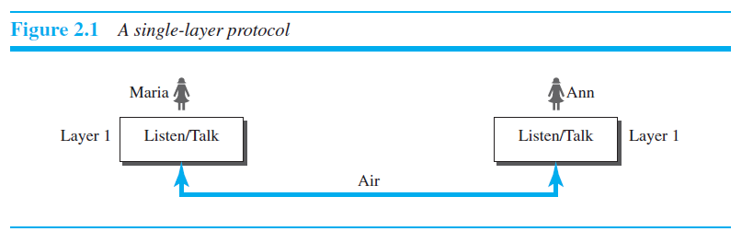
Scenarios
First Scenario
Department of Computer Science, Presidency University

Slide 5
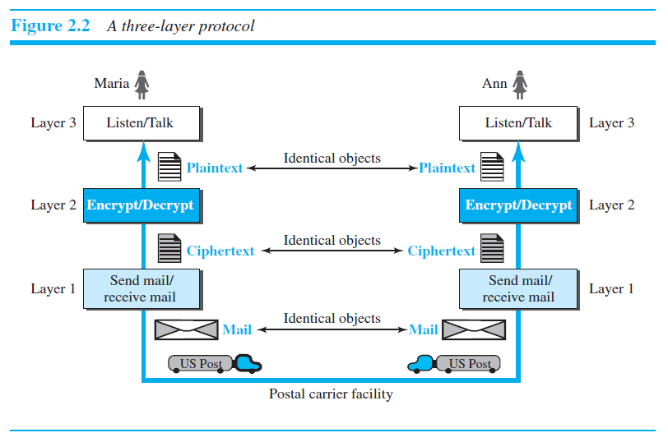
Second scenario
Department of Computer Science, Presidency University

Slide 6
Principles of Protocol Layering
First Principle
The first principle dictates that if we want bidirectional communication, we need to make each layer so that it is able to perform two opposite tasks, one in each direction. For example, the third layer task is to listen (in one direction) and talk (in the other direction). The second layer needs to be able to encrypt and decrypt. The first layer needs to send and receive mail.
Second Principle
The second principle that we need to follow in protocol layering is that the two objects under each layer at both sites should be identical. For example, the object under layer 3 at both sites should be a plaintext letter. The object under layer 2 at both sites should be a cipher text letter. The object under layer 1 at both sites should be a piece of mail.
Department of Computer Science, Presidency University

Slide 7
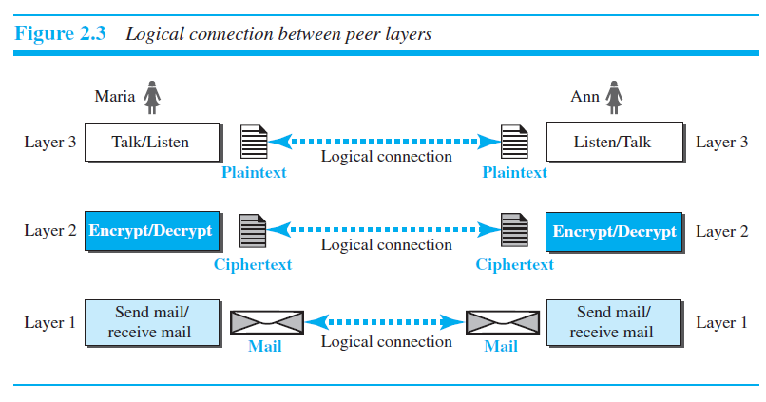
Logical Connections
Department of Computer Science, Presidency University

Slide 8
TCP/IP PROTOCOL SUITE
Now that we know about the concept of protocol layering and the logical communication between layers we can introduce the TCP/IP (Transmission Control Protocol/Internet Protocol).
TCP/IP is a protocol suite (a set of protocols organized in different layers) used in the Internet today.
It is a hierarchical protocol made up of interactive modules, each of which provides a specific functionality.
The term hierarchical means that each upper level protocol is supported by the services provided by one or more lower level protocols.
TCP/IP is a five layered model architecture.
Department of Computer Science, Presidency University

Slide 9
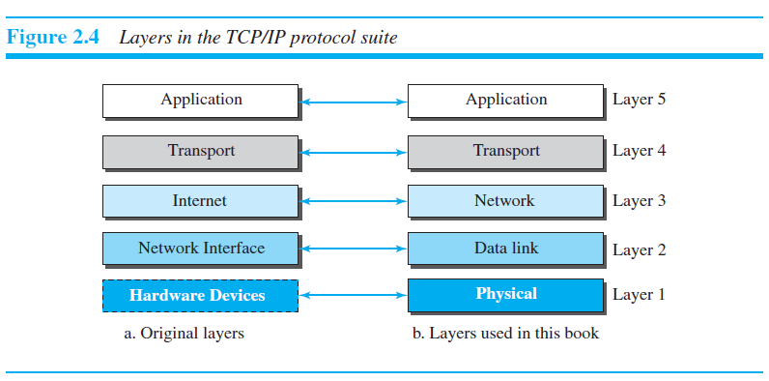
Layered Architecture
Department of Computer Science, Presidency University

Slide 10
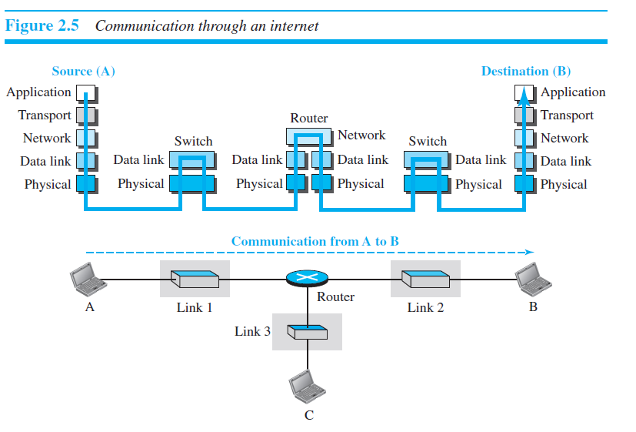
Layered Architecture
Department of Computer Science, Presidency University

Slide 11
Layered Architecture
Let us assume that computer A communicates with computer B. As the figure shows, we have five communicating devices in this communication: source host (computer A), the link-layer switch in link 1, the router, the link-layer switch in link 2, and the destination host (computer B).
Each device is involved with a set of layers depending on the role of the device in the internet. The two hosts are involved in all five layers; the source host needs to create a message in the application layer and send it down the layers so that it is physically sent to the destination host.
The destination host needs to receive the communication at the physical layer and then deliver it through the other layers to the application layer.
Department of Computer Science, Presidency University

Slide 12
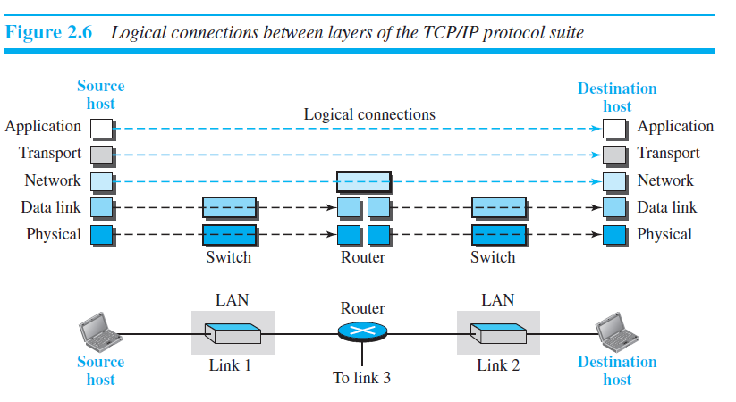
Logical Connections
Department of Computer Science, Presidency University

Slide 13
Cntd…
Using logical connections makes it easier for us to think about the duty of each layer.
As the figure above shows, the duty of the application, transport, and network layers is end to-end.
However, the duty of the data-link and physical layers is hop-to-hop, in which a hop is a host or router.
Department of Computer Science, Presidency University

Slide 14
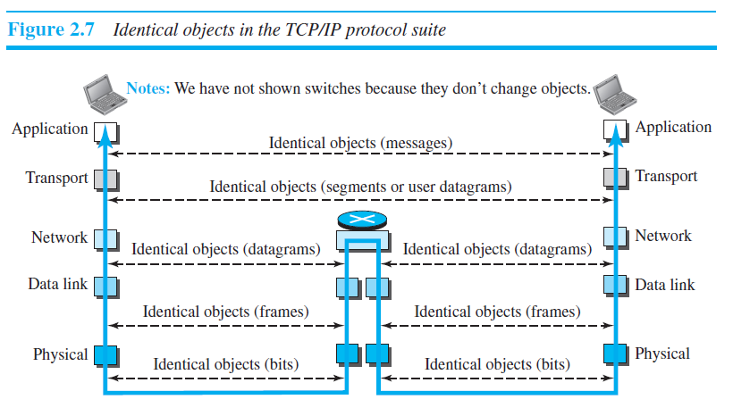
Identical objects in the TCP/IP protocol suite
Figure below shows the second principle discussed previously for protocol layering. We show the identical objects below each layer related to each device.
Department of Computer Science, Presidency University

Slide 15

Layers in the TCP/IP Protocol Suite
After understanding the concept of logical communication, we are ready to briefly discuss the duty of each layer. Our discussion in this chapter will be very brief, but we come back to the duty of each layer in next chapters.
Physical Layer
“The physical layer is responsible for movements of individual bits from one hop (node) to the next.”
Department of Computer Science, Presidency University

Slide 16
Cntd…
Although the physical layer is the lowest level in the TCP/IP protocol suite, the communication between two devices at the physical layer is still a logical communication because there is another, hidden layer, the transmission media, under the physical layer.
Two devices are connected by a transmission medium (cable or air). We need to know that the transmission medium does not carry bits; it carries electrical or optical signals.
So the bits received in a frame from the data-link layer are transformed and sent through the transmission media, but we can think that the logical unit between two physical layers in two devices is a bit.
There are several protocols that transfer bit to a signal
Department of Computer Science, Presidency University

Slide 17

Data Link Layer
“The data link layer is responsible for moving frames from one hop (node) to the next.”
Figure below shows the relationship of the data link layer to the network and physical layers.
Figure: Data link layer
Department of Computer Science, Presidency University

Slide 18
Cntd…
We have seen that an internet is made up of several links (LANs and WANs) connected by routers.
There may be several overlapping sets of links that a datagram can travel from the host to the destination.
The routers are responsible for choosing the best links.
However, when the next link to travel is determined by the router, the data-link layer is responsible for taking the frames and moving it across the link.
This layer provides complete error detection and correction.
Department of Computer Science, Presidency University

Slide 19

Network Layer
“The network layer is responsible for the delivery of individual packets from the source host to the destination host.”
Figure below shows the relationship of the network layer to the data link and transport layers.
Figure: Network layer
Department of Computer Science, Presidency University

Slide 20
Network Layer
The network layer is responsible for the source-to-destination delivery of a packet, possibly across multiple networks.
The communication at the network layer is host-to-host. However, since there can be several routers from the source to the destination, the routers in the path are responsible for choosing the best route for each packet.
If two systems are connected to the same link, there is usually no need for a network layer.
However, if the two systems are attached to different networks with connecting devices between the networks, there is often a need for the network layer to accomplish source-to-destination delivery.
Department of Computer Science, Presidency University

Slide 21
Network Layer
Again, we may ask ourselves why we need the network layer. We could have added the routing duty to the transport layer and dropped this layer.
One reason, as we said before, is the separation of different tasks between different layers.
The second reason is that the routers do not need the application and transport layers.
Separating the tasks allows us to use fewer protocols on the routers.
The network layer in the Internet includes the main protocol, Internet Protocol (IP), that defines the format of the packet, called a datagram at the network layer.
IP is also responsible for routing a packet from its source to its destination, which is achieved by each router forwarding the datagram to the next router in its path.
IP is a connectionless protocol that provides no flow control, no error control, and no congestion control services. This means that if any of these services is required for an application, the application should rely only on the transport-layer protocol.
Department of Computer Science, Presidency University

Slide 22
Network Layer
The network layer also has some auxiliary protocols that help IP in its delivery and routing tasks.
The Internet Control Message Protocol (ICMP) helps IP to report some problems when routing a packet.
The Internet Group Management Protocol (IGMP) is another protocol that helps IP in multitasking.
The Dynamic Host Configuration Protocol (DHCP) helps IP to get the network-layer address for a host.
The Address Resolution Protocol (ARP) is a protocol that helps IP to find the link-layer address of a host.
Department of Computer Science, Presidency University

Slide 23
Transport Layer
The logical connection at the transport layer is also end-to-end.
The transport layer at the source host gets the message from the application layer, encapsulates it in a transport layer packet (called a segment) and sends it, through the logical (imaginary) connection, to the transport layer at the destination host.
In other words, the transport layer is responsible for giving services to the application layer: to get a message from an application program running on the source host and deliver it to the corresponding application program on the destination host.
1.4.2.2
Department of Computer Science, Presidency University

Slide 24
Transport Layer
There are a few transport-layer protocols in the Internet, each designed for some specific task. The main protocol, Transmission Control Protocol (TCP), is a connection oriented protocol that first establishes a logical connection between transport layers at two hosts before transferring data.
TCP provides flow control (matching the sending data rate of the source host with the receiving data rate of the destination host to prevent overwhelming the destination), error control (to guarantee that the segments arrive at the destination without error and resending the corrupted ones), and congestion control to reduce the loss of segments due to congestion in the network.
The other common protocol, User Datagram Protocol (UDP), is a connectionless protocol that transmits user datagrams without first creating a logical connection. UDP is a simple protocol that does not provide flow, error, or congestion control.
Department of Computer Science, Presidency University

Slide 25
Application Layer
The application layer is responsible for providing services to the user.
The two application layers exchange messages between each other as though there were a bridge between the two layers. However, we should know that the communication is done through all the layers.
Communication at the application layer is between two processes (two programs running at this layer). To communicate, a process sends a request to the other process and receives a response. Process-to-process communication is the duty of the application layer.
The Hypertext Transfer Protocol (HTTP) is a vehicle for accessing the World Wide Web (WWW).
The Simple Mail Transfer Protocol (SMTP) is the main protocol used in electronic mail (e-mail) service.
Department of Computer Science, Presidency University

Slide 26
Application Layer
The File Transfer Protocol (FTP) is used for transferring files from one host to another.
The Simple Network Management Protocol (SNMP) is used by an administrator to manage the Internet at global and local levels.
The Domain Name System (DNS) is used by other protocols to find the network-layer address of a computer.
Department of Computer Science, Presidency University

Slide 27
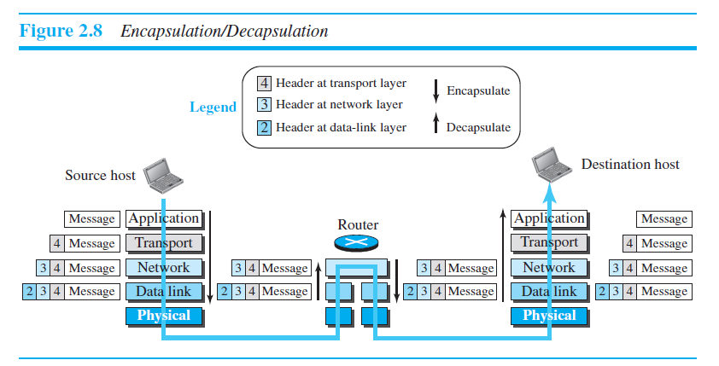
Encapsulation and Decapsulation
One of the important concepts in protocol layering in the Internet is Encapsulation/ Decapsulation.
Department of Computer Science, Presidency University

Slide 28
Encapsulation at the Source Host
At the source, we have only encapsulation.
At the application layer, the data to be exchanged is referred to as a message. The message is passed to the transport layer.
The transport layer takes the message as the payload, It adds the transport layer header to the payload, which contains the identifiers of the source and destination application programs that want to communicate plus some more information that is needed for the end-to-end delivery of the message, such as information needed for flow, error control, or congestion control. The result is the transport-layer packet, which is called the segment (in TCP) and the user datagram (in UDP).The transport layer then passes the packet to the network layer.
Department of Computer Science, Presidency University

Slide 29
Encapsulation at the Source Host
The network layer takes the transport-layer packet as data or payload and adds its own header to the payload. The header contains the addresses of the source and destination hosts and some more information used for host to host delivery. The result is the network-layer packet, called a datagram. The network layer then passes the packet to the data-link layer.
The data-link layer takes the network-layer packet as data or payload and adds its own header, which contains the link-layer addresses of the host or the next hop (the router). The result is the link-layer packet, which is called a frame. The frame is passed to the physical layer for transmission.
Department of Computer Science, Presidency University

Slide 30
Decapsulation and Encapsulation at the Router
After the set of bits are delivered to the data-link layer, this layer decapsulates the datagram from the frame and passes it to the network layer.
The network layer only inspects the source and destination addresses in the datagram header and consults its forwarding table to find the next hop to which the datagram is to be delivered. The datagram is then passed to the data-link layer of the next link.
The data-link layer of the next link encapsulates the datagram in a frame and passes it to the physical layer for transmission.
Department of Computer Science, Presidency University

Slide 31
Decapsulation at the Destination Host
At the destination host, each layer only decapsulates the packet received, removes the payload, and delivers the payload to the next-higher layer protocol until the message reaches the application layer.
Department of Computer Science, Presidency University

Slide 32
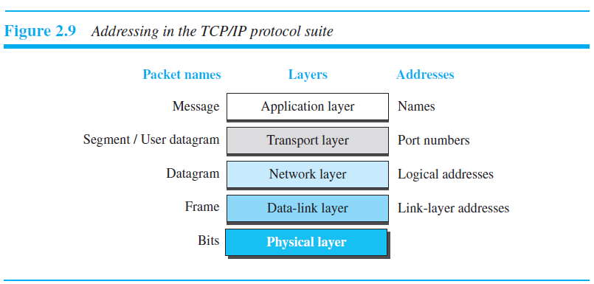
Addressing
Any communication that involves two parties needs two addresses: source address and destination address.
Department of Computer Science, Presidency University

Slide 33
Addressing
At the application layer, we normally use names to define the site that provides services, such as someorg.com, or the e-mail address such as somebody @gmail.com.
At the transport layer, addresses are called port numbers, and these define the application-layer programs at the source and destination.
At the network-layer, addresses are called Logical addresses or IP address. A network layer address uniquely defines the connection of a device to the Internet.
At the data link layer, addresses are called MAC address or link-layer address which are locally defined addresses.
Department of Computer Science, Presidency University

Slide 34
THE OSI MODEL
Established in 1947, the International Standards Organization (ISO) is a multinational body dedicated to worldwide agreement on international standards.
An ISO standard that covers all aspects of network communications is the Open Systems Interconnection (OSI) model. It was first introduced in the late 1970s.
An open system is a set of protocols that allows any two different systems to communicate regardless of their underlying architecture.
ISO is the organization; OSI is the model.
Department of Computer Science, Presidency University

Slide 35
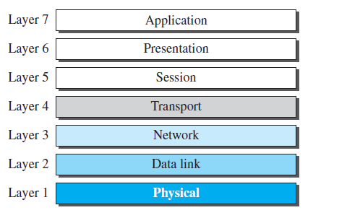
THE OSI MODEL
The OSI model is a layered framework for the design of network systems that allows communication between all types of computer systems. It consists of seven separate but related layers, each of which defines a part of the process of moving information across a network
Department of Computer Science, Presidency University

Slide 36
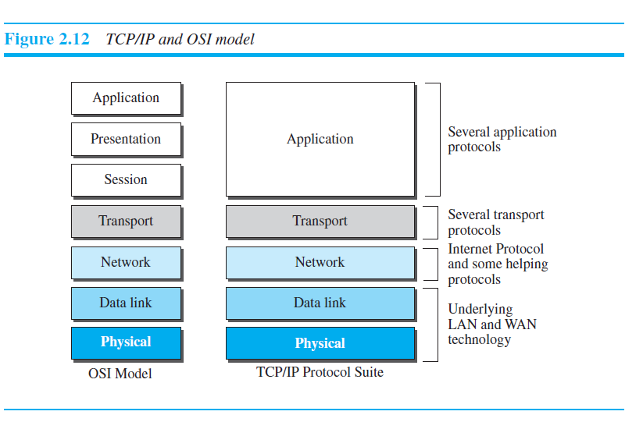
OSI versus TCP/IP
Department of Computer Science, Presidency University

Slide 37

TCP/IP and OSI model
Department of Computer Science, Presidency University

Slide 38
Department of Computer Science, Presidency University

